Slide 1

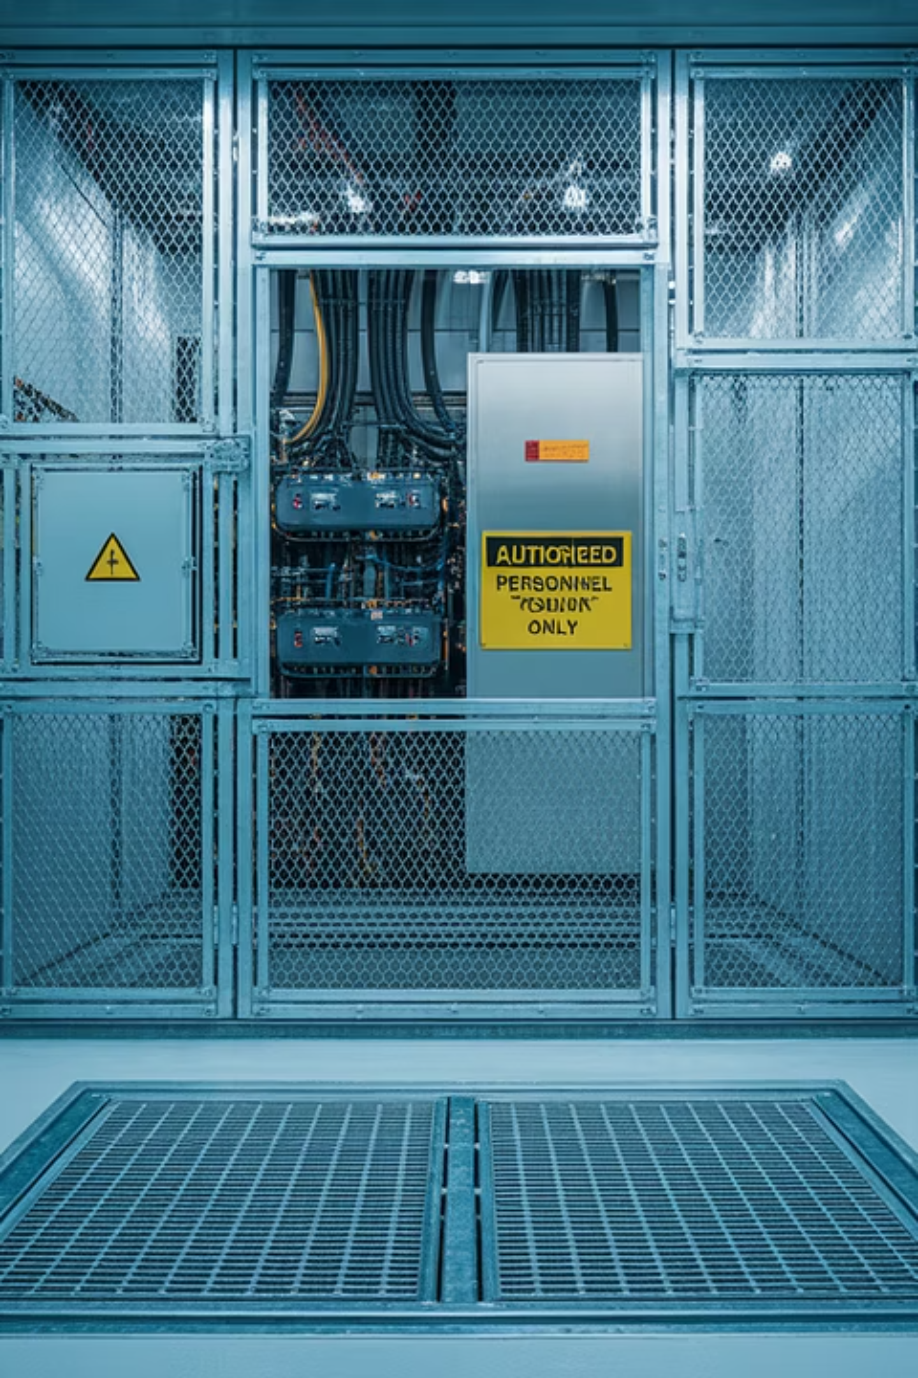
Elevator Installation Safety: Lessons from a Fatal Accident
This presentation examines a critical safety incident during elevator installation and the essential preventive measures that could have saved a life. We'll explore the circumstances, root causes, and key takeaways to prevent similar accidents in the future.

Slide 2


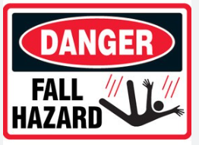
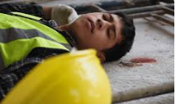

The Incident: Supervisor Fatality
1
The Accident
An installation supervisor fell from the machine room onto the building terrace through an uncovered trap door provision.
2
The Injury
While falling, his head hit the edge of the trap door frame, rendering him unconscious.
3
The Outcome
Despite site erectors rushing him to the hospital, the supervisor was pronounced dead on arrival.

Slide 3
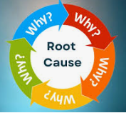
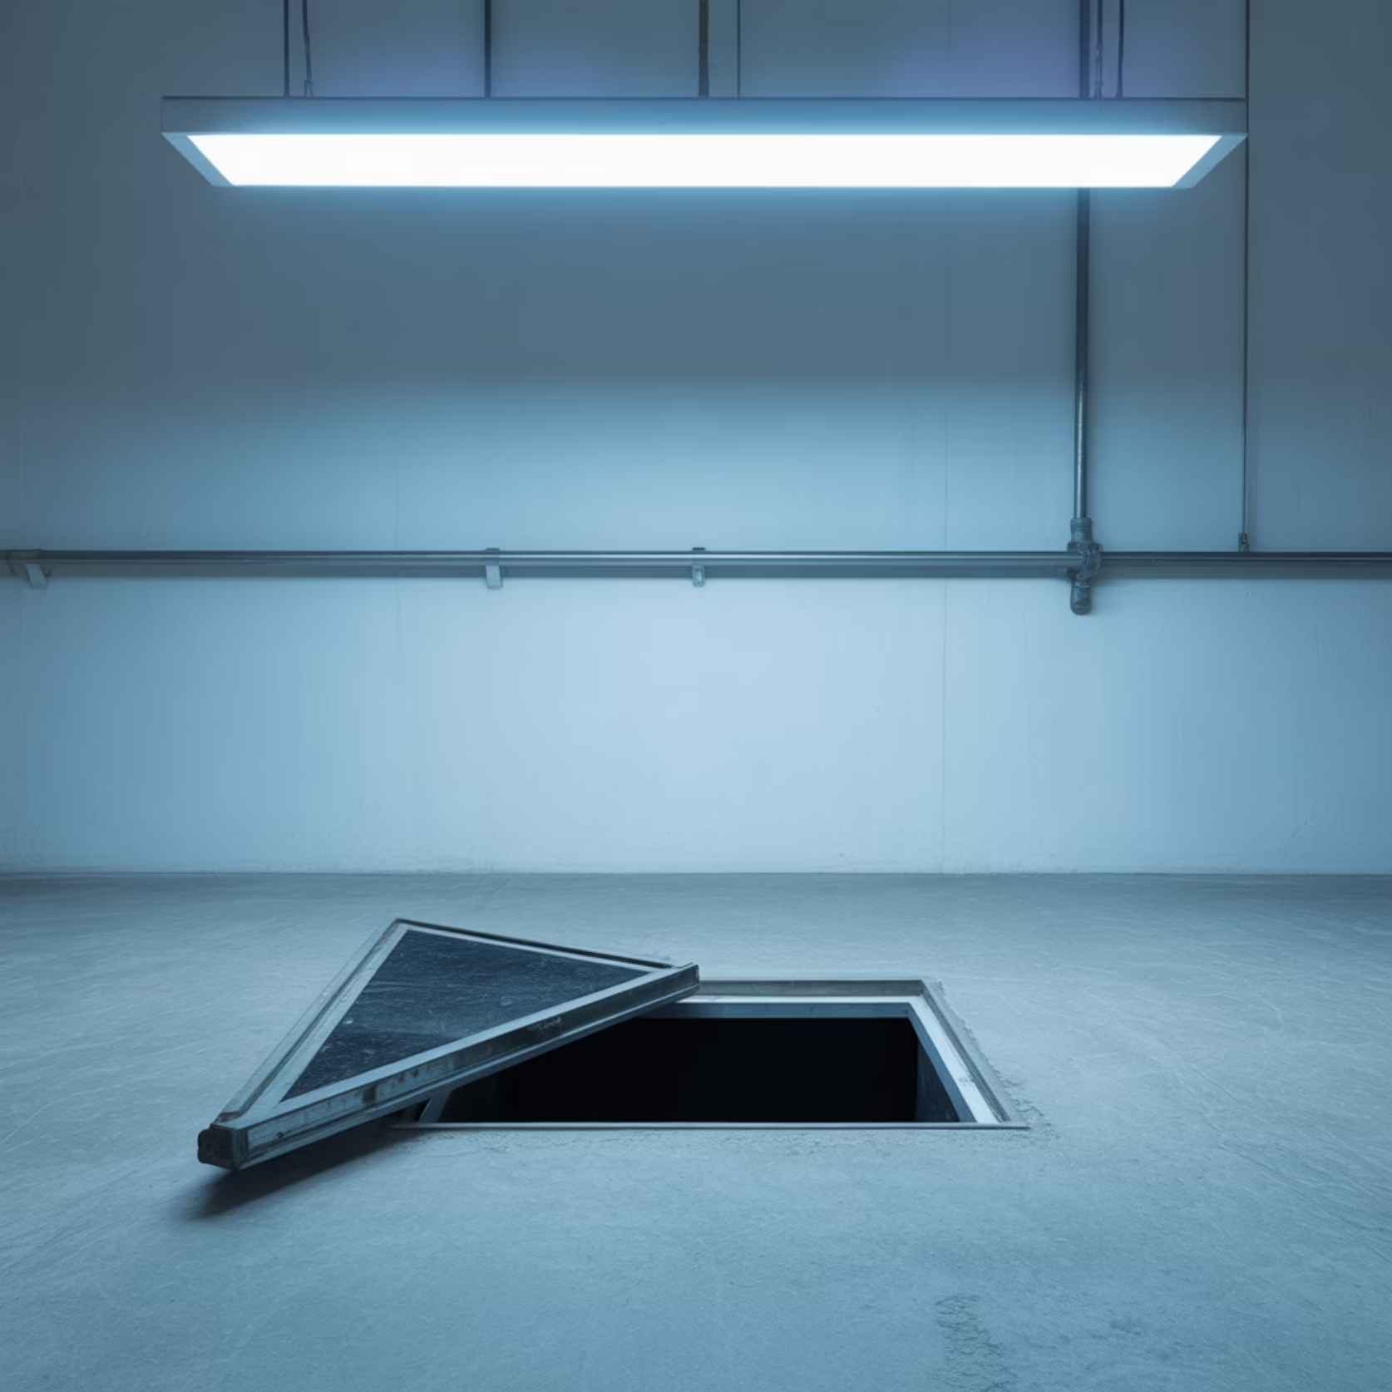
Root Causes Analysis
Customer Negligence
The trap door cover was not provided by the customer despite follow-up by the erector.
Missing Safety Measures
No barricade or caution board was provided to prevent falls through the opening.
Process Failure
Pre-installation checklist was not carried out properly, and the process for completion of customer's responsibilities was not followed.

Slide 4



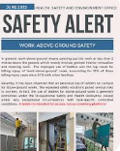


Immediate & Preventive Actions
Immediate Correction
Safety Alert
Process Enforcement
Cover was immediately provided for the trap door after the incident.
Safety Department shared an alert with all field employees about the incident and proper procedures.
Employees were cautioned not to start installation until all preliminary customer requirements are completed.
Any exceptions requiring work with safety discrepancies now need manager approval,
and temporary guards must be provided until permanent solutions are installed.

Slide 5

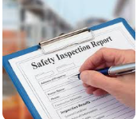

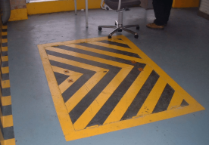
Key Takeaways: Preventing Future Tragedies- GO -NO-GO
Never Compromise on Safety Checklists
Temporary Safeguards Are Essential
Complete all pre-installation safety checks without exception before beginning work. Provide zebra painting on all trap doors
Always install temporary barriers when permanent safety features are not yet in place.
Clear Communication is Critical
Ensure all stakeholders understand their safety responsibilities and verify completion before proceeding.
For any Support connect us on
Info@elevate-iqsolutions.com

