Slide 1

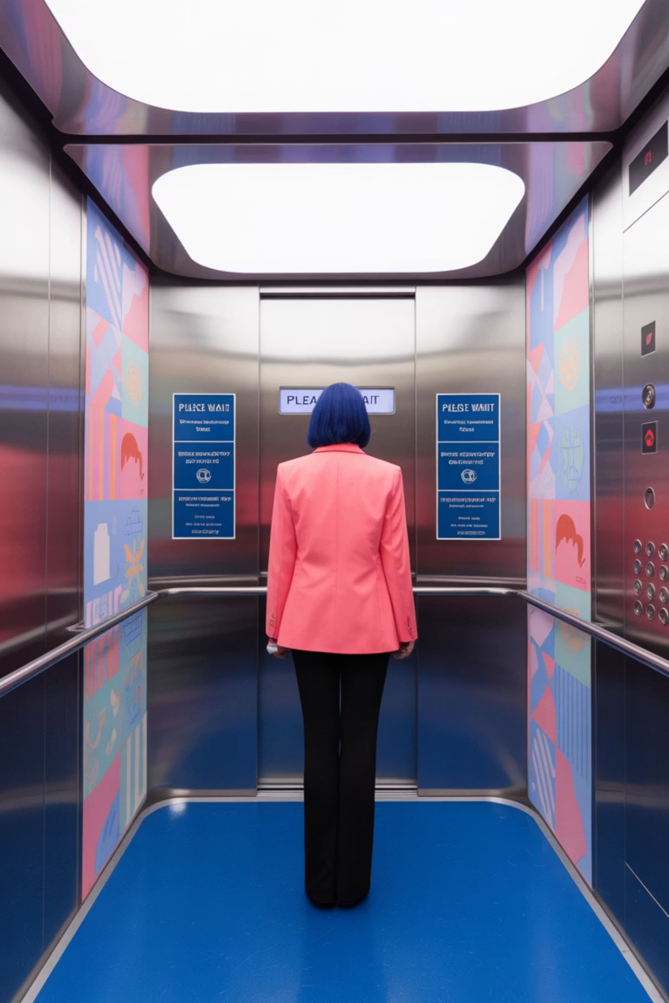
Elevator Safety: Essential Dos and Don'ts for Users
In India, 62% of adults report elevator safety concerns. The economic toll exceeds ₹35,000 crore annually from preventable accidents.
One-third of all elevator incidents could be avoided through proper passenger behavior. This guide will help you stay safe.
SS

Slide 2




Understanding Elevator Regulations in India
Bureau of Indian Standards (BIS) Code IS 14665
Establishes critical safety requirements for elevator installation and maintenance throughout India.
National Building Code (NBC) Part 8
Contains detailed provisions for lift design, operations and regular inspections.
State-specific Lift Acts
Regional regulations that enforce compliance with safety standards for all elevator installations.

Slide 3

Common Elevator Accidents: Overcrowding
35%
68 KG/pass
Incident Rate
Capacity Limit
Of elevator incidents caused by exceeding capacity limits
Standard weight limit for residential lifts often ignored
Passenger Elevators 5,6,8,10,13,16,20,..... 200 Kg
Freight Elevators
1,2, 3,4 Ton.....

Slide 4








Common Elevator Accidents: Door Interference
Highest Risk: Children
Most vulnerable to door-related injuries
Dangerous Action: Forcing Doors
27% of injuries from manually forcing doors
Equipment Impact: Safety Interlocks
40% of serious accidents from disrupted interlocks
Lack of Maintenance
₹25,000 average for door mechanism damage

Slide 5


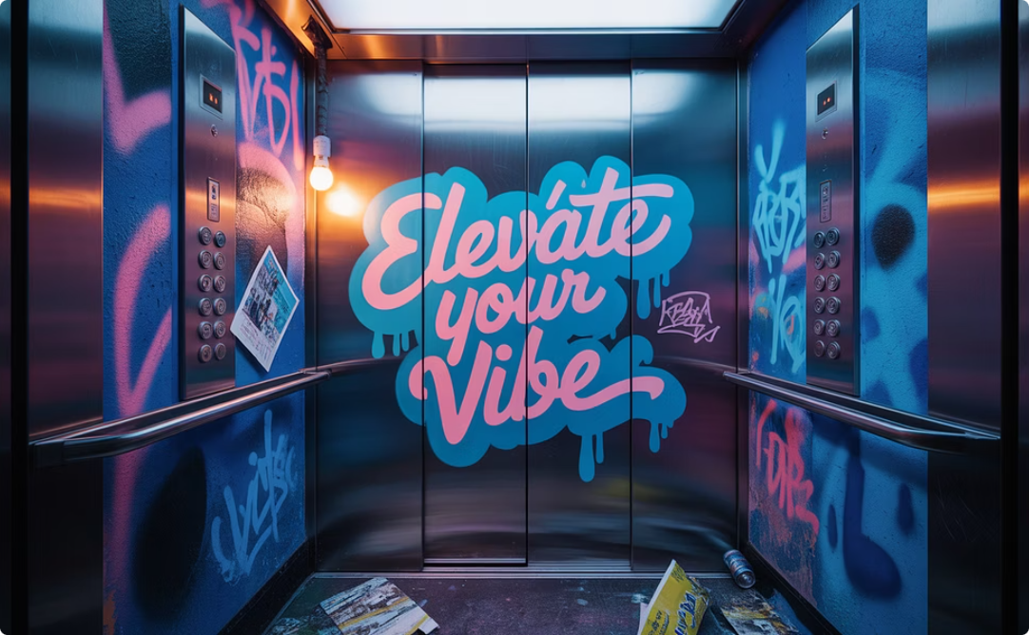
Common Elevator Accidents: Improper Use
Jumping Hazards
Door Holding
Vandalism Impact
Causes sensor malfunction in 22% of breakdowns. Dangerous to all passengers.
Extended door holding damages motors. Creates costly maintenance issues.
Costs Indian buildings ₹120 crore annually in unnecessary repairs.

Slide 6








Safety Feature: Final Limit Switch
Overtravel Prevention
Power Interruption
Stops elevator from traveling beyond terminal floors
Automatically cuts power when activated
Effectiveness Rate
Regulatory Compliance
99.7% effective in preventing accidents
Required by IS 14665 safety standards

Slide 7
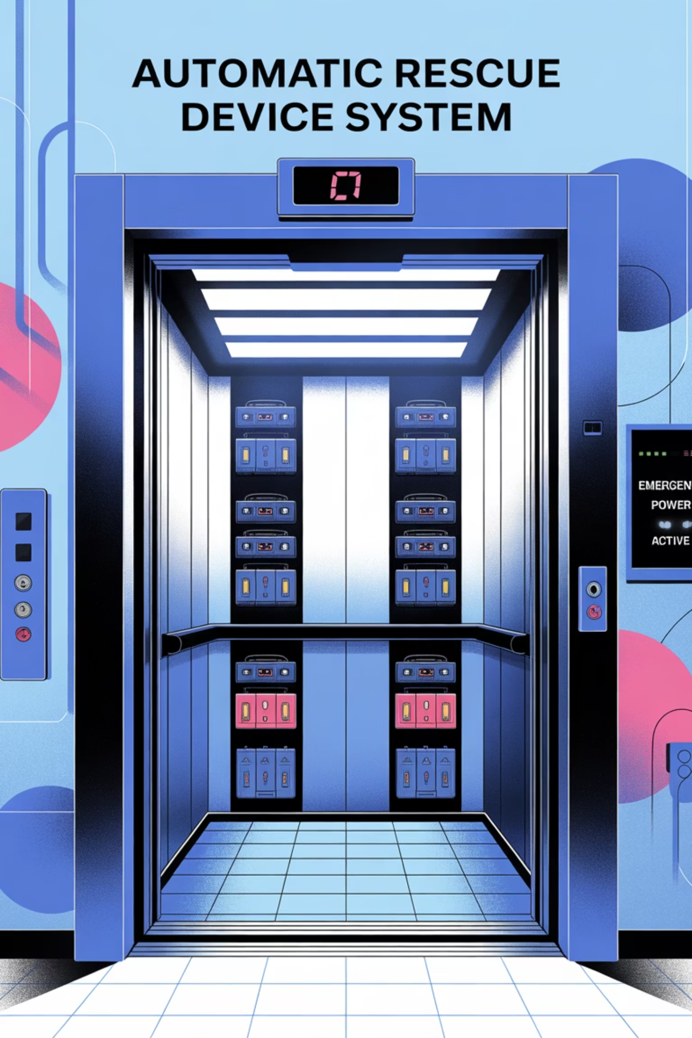




Safety Feature: Automatic Rescue Device (ARD)
Power Failure Detection
Monitors electrical supply continuously
Backup System Activation
Switches to battery power automatically
Safe Floor Movement
Brings elevator to nearest floor level
Door Opening
Automatically opens doors for passenger exit

Slide 8
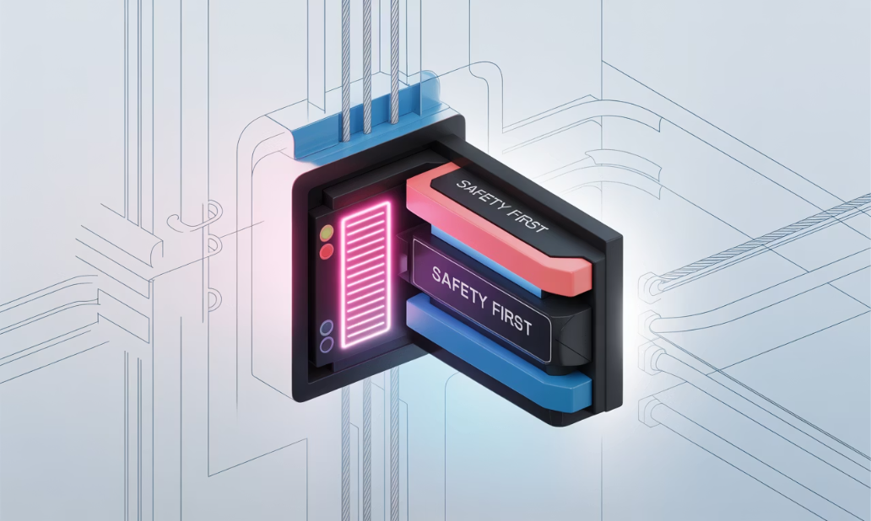
Safety Feature: Door Safety Mechanisms
Sensor Technologies
Interlock Systems
Infrared light curtains
Mechanical locks
Pressure-sensitive edges
Electrical safety circuits
Motion detection systems
Redundant verification
These sensors detect obstructions and prevent doors from closing on passengers.
Door interlocks ensure proper operation and prevent accidents.
Door safety systems reduce injuries by 85% according to Indian safety statistics.

Slide 9



Safety Feature: Buffer Systems & Braking Mechanisms
Emergency Brakes
Activate automatically during system failures
Buffer Systems
Absorb impact at bottom of shaft
Redundant Safeguards
Multiple systems ensure passenger protection
These systems are 98% effective in preventing serious injuries during system failures, as required by IS specifications.

Slide 10
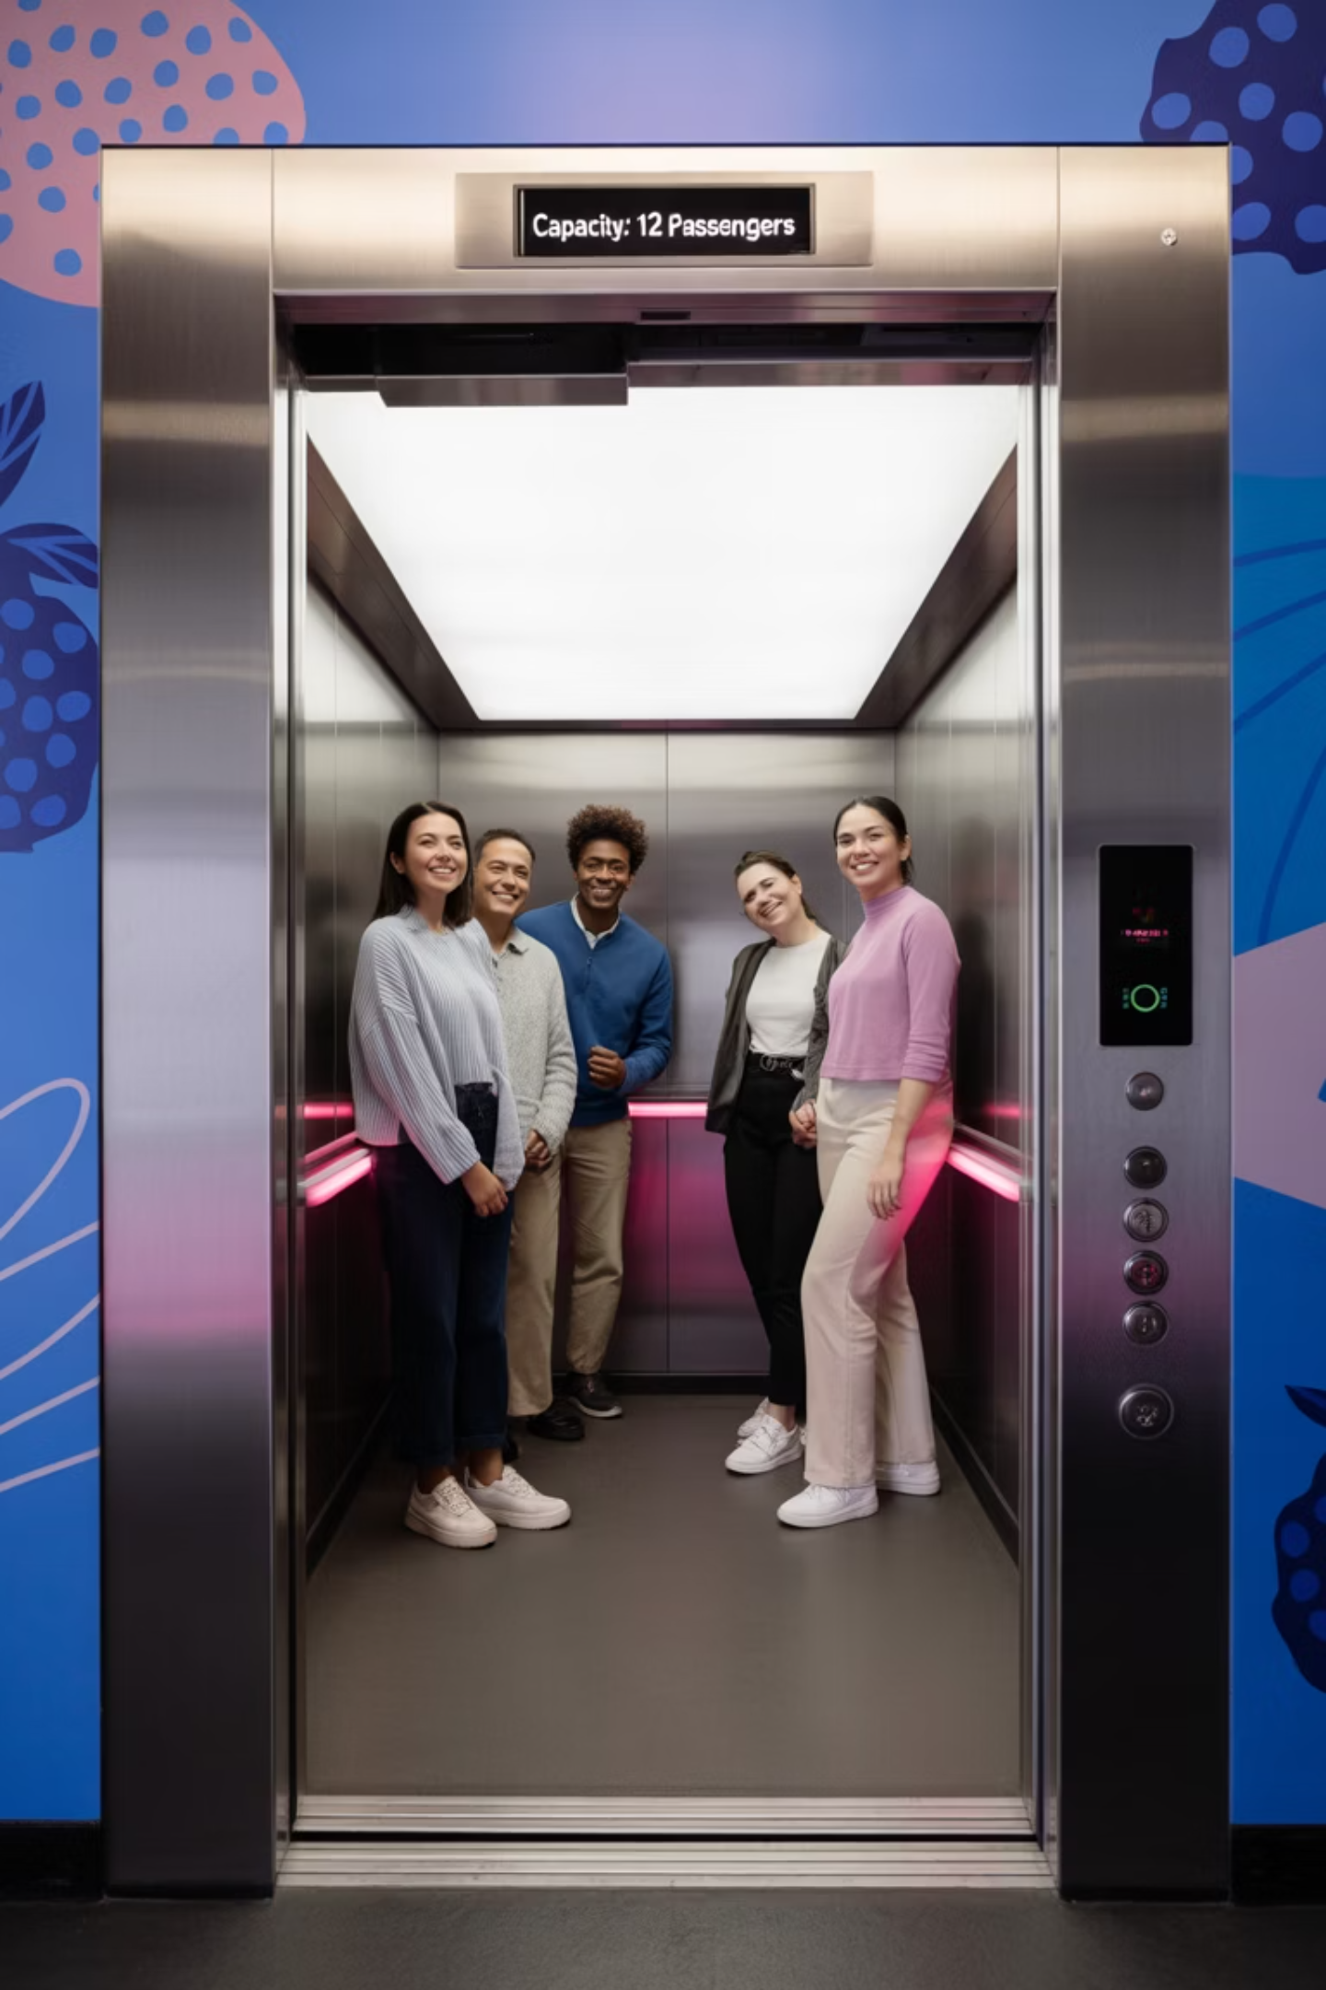
DO: Follow Capacity Limits
Observe Weight Restrictions
Practice Patience
Wait for the next elevator if the car is already full. Safety trumps convenience.
Check posted limits (typically 272 kg for 4 persons) and never exceed them.
Maintain Order
Stand clear of doors during entry/exit and distribute weight evenly inside the car.

Slide 11
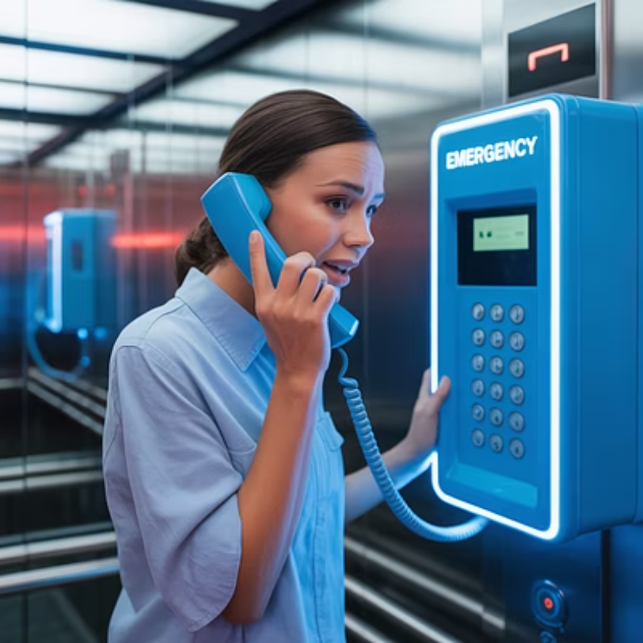
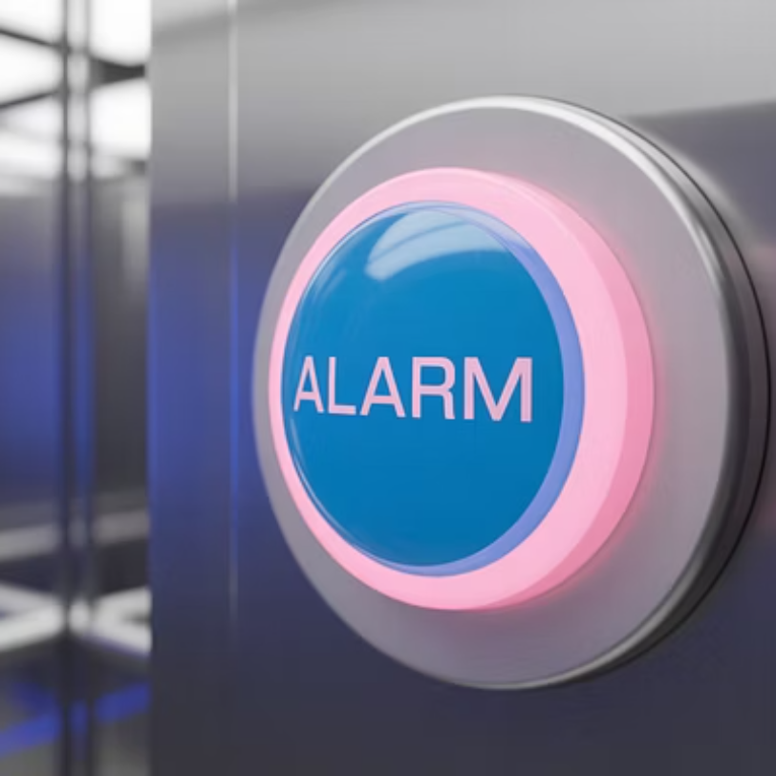
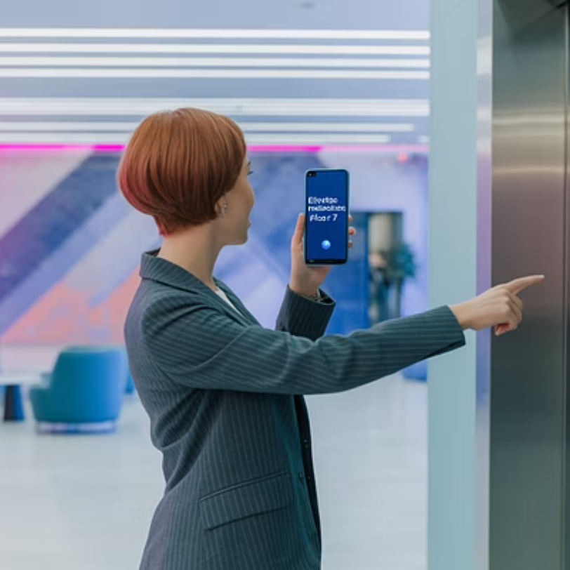
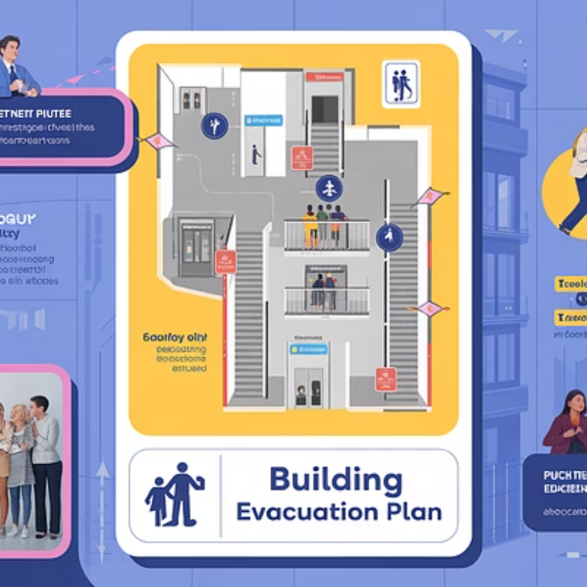
DO: Use Emergency Features Appropriately
Emergency features are critical safety systems. Use the alarm only for actual emergencies. Each false alarm costs approximately ₹5,000 to address.

Slide 12

DO: Practice Proper Entry and Exit
Wait for Exiting Passengers
Allow those inside to exit before attempting to enter the elevator.
Use Door Control Properly
Hold doors using only designated buttons, never manually force them.
Prioritize Those in Need
Give way to elderly, pregnant women, and disabled persons.

Slide 13
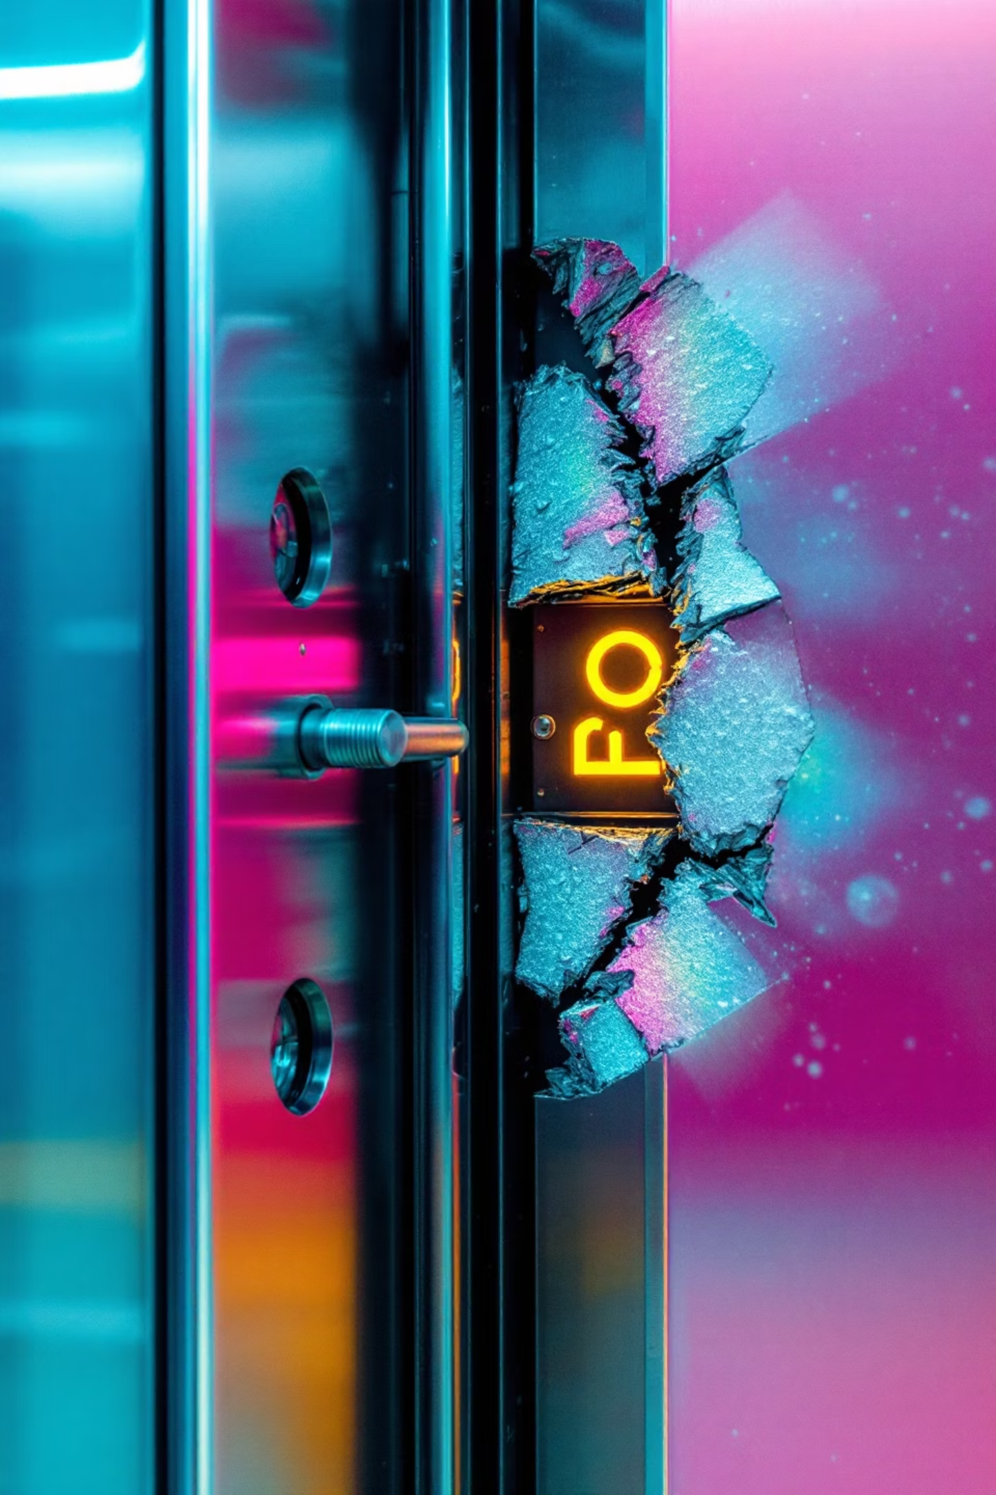




DON'T: Interfere with Door Operation
No Forcing
No Blocking
No Holding
Never force doors open or closed manually. Wait for automatic operation.
Don't block doors with objects or limbs. This damages sensors and mechanisms.
Don't hold doors open for extended periods. This strains motors and causes failures.
Costly Repairs
Door mechanism repairs cost between ₹15,000-₹30,000 for each incident.

Slide 14
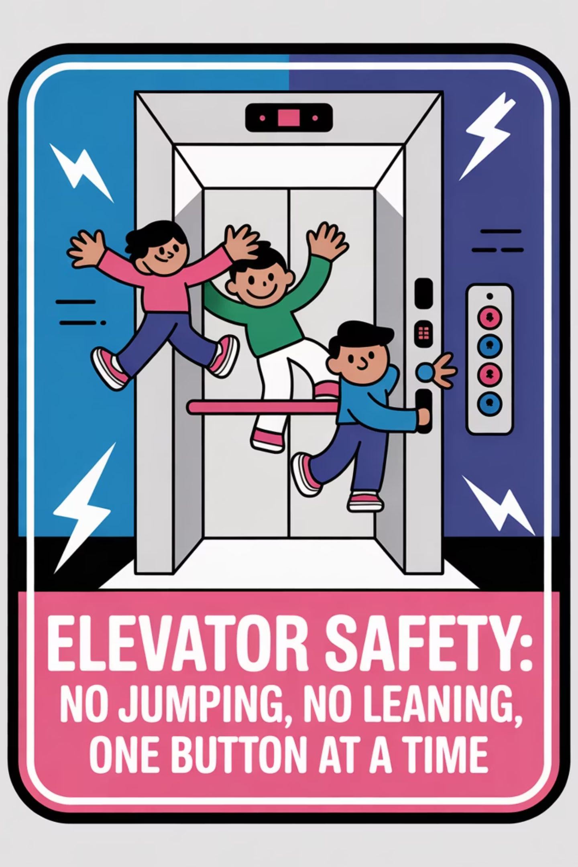
DON'T: Misuse Elevator Equipment
Dangerous Behavior
Consequence
Proper Alternative
Jumping or bouncing
Triggers safety stops
Stand still while riding
Pressing multiple buttons
Wastes energy, causes delays
Press only your destination floor
Leaning against doors
Can trigger sensors or mechanisms
Stand in center of car
Self-rescue attempts
Extremely dangerous
Wait for professional help

Slide 15







Summary: Creating a Safer Elevator Environment
Proper Entry/Exit
Report Issues
Wait your turn and avoid blocking doors
Alert management about maintenance problems
Respect Capacity
Never exceed posted weight and passenger limits
Consider Alternatives
Use stairs for short trips when possible
2

